Slide 1


Home TV Shows Movies Recently Added My List
KIDS DVD
What to watch next?
2019
TV-PG
A report was released in 2018 that showed the number of TV shows on Netflix has almost tripled since 2010, however, movies have decreased by more than 2,000. Movies and TV shows available on Netflix will be the focus of this presentation and a recommendation system, so that viewers may identify what to watch next based on their current viewing.
▶ PLAY
+ MY LIST
Staring: April Meyer
Genre: Data Science, Recommendation
This Show is: DSC680-T301 Applied Data Science (2215-1)
OVERVIEW EPISODES TRAILERS & MORE MORE LIKE THIS DETAILS

Slide 2
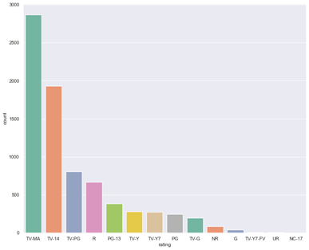
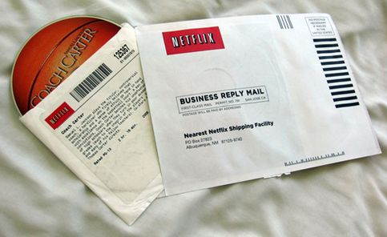
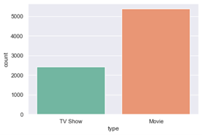
Home TV Shows Movies Recently Added My List
KIDS DVD
Preliminary Analysis
Season 1
Background
Data Sources
Data Exploration
• show_id: Unique ID for every Movie / Tv Show
• type: Identifier - A Movie or TV Show
• title: Title of the Movie / Tv Show
• director: Director of the Movie
• cast: Actors involved in the movie / show
• country: Country where the movie / show was produced
• date_added: Date it was added on Netflix
• release_year: Actual Release year of the move / show
• rating: TV Rating of the movie / show
• duration: Total Duration - in minutes or number of seasons
• listed_in: Genere
• description: The summary description
A report was released in 2018 that showed the number of TV shows on Netflix has almost tripled since 2010, however, movies have decreased by more than 2,000. Movies and TV shows available on Netflix will be my domain for this first project (1). I wanted to investigate what other findings can be acquired from their streaming content.
The data explored was collected from Flixable they are a third-party Netflix search engine (2). It contains movies and TV shows that are available on Netflix as of 2019. The data is from Kaggle. Link to data, https://www.kaggle.com/shivamb/netflix-shows
OVERVIEW EPISODES TRAILERS & MORE MORE LIKE THIS DETAILS

Slide 3
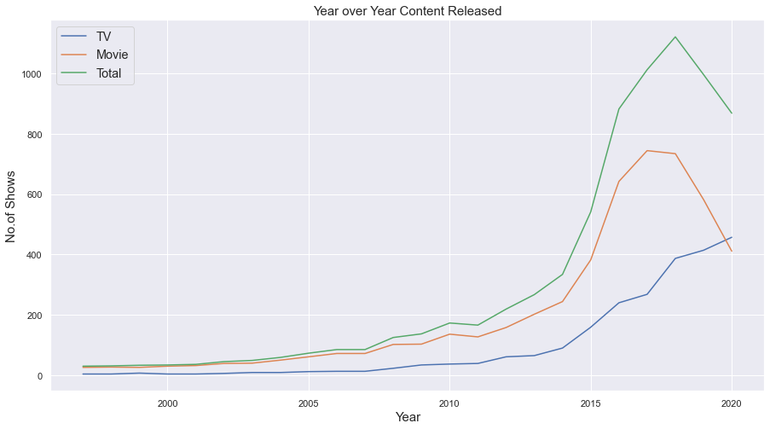
Home TV Shows Movies Recently Added My List
KIDS DVD
Content
OVERVIEW EPISODES TRAILERS & MORE MORE LIKE THIS DETAILS

Slide 4

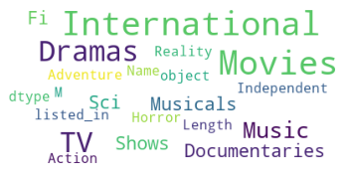
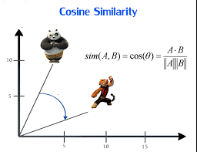
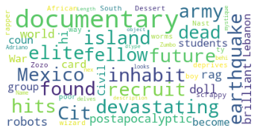
Home TV Shows Movies Recently Added My List
KIDS DVD
Recommendation System
Problem Statement
Methods
Data Preparation
Results
To develop a recommendation system, so that viewers may identify what to watch next based on their current viewing. A recommender system uses current activity to recommend the suggest a similar item (4). Amazon, Facebook, and Netflix all use these machine learning algorithms to help the user (4).
The method used for this project is a cosine similarity to create a recommender system. Cosine Similarity is a measurement used to establish the similarity between two items no matter the size (5). It calculates the cosine of the angle between two vectors in a multi-dimensional space (5).
A new feature was created called combined_fields. It contained cast, director, listed_in, and description. Before combining cast and director all NAs were filled in with ‘Unknown’. Next the combined field required all words to be tokenized and preprocessed by changing to lower case, removing symbols, and stop words.,
A function was built called get_reommendations(title). It gets the pairwise similarity scores of all content with that content and returns the ten most similar. It performed well when tested with a couple titles. For example, ‘The Umbrella Academy’ returned ‘The Future of Water’, ‘The Staircase’, ‘Maharakshak Devi’, ‘The 4400’, ‘Mighty Little Bheem’, ‘Locke & Key’, ‘Nightflyers’, ‘Charmed’, ‘The Dragon Prince’, and ‘Biohackers’.
OVERVIEW EPISODES TRAILERS & MORE MORE LIKE THIS DETAILS

Slide 5
Home TV Shows Movies Recently Added My List
KIDS DVD
Questions & Answers
1. What TV shows have the most episodes?
What are the top movie genres?
When is the best time to release content?
4. What type of content does Netflix have more of?.
5. Do you think there is other supplemental data that would have helped?
Why did you pick the features (director, listed_in, cast, and description) for the recommendation?
What are some other ways to build a recommendation system?
How could this be used in other fields or industries?
What did you find most interesting about the data set?
What was your biggest challenge?
OVERVIEW EPISODES TRAILERS & MORE MORE LIKE THIS DETAILS

